Slide 1

SUMMATIVE ORAL PRESENTATION FOR PROBLEM A (ETCEMBLY LTD) GROUP NO - 4
DATA SCIENCE MINI PROJECT 2024
SHALOMI FERNANDES,
JIADONG XU,
FANGNAN WEI,
JIAHUI LIU.

Slide 2
PRE-PROCESSING STEPS:
Data preprocessing includes four steps: retaining relevant columns of data, deleting rows with missing values, deleting duplicate rows, and deleting rows with ‘vdjdb.score’ = 0.
Extract relevant columns: 'complex.id', 'gene', 'cdr3', 'v.segm', 'j.segm', 'species', 'mhc.a', 'mhc.b', ' from the original data set mhc.class', 'antigen.epitope', 'vdjdb.score’.
Find the missing values and find that there are missing values in the ‘v.segm’ and ‘j.segm’ columns. Delete the rows where these missing values are located.
Remove duplicate rows
Because the data entry of ‘vdjdb.score’ = 0 has no reference significance, delete the row where ‘vdjdb.score’ = 0 is located.

Slide 3
ENCODING METHODS USED: ONE-HOT We use three methods for encoding, they are ONE-HOT, BLOSUM 62 and GIANA ENCODING.
ONE-HOT:
ONE-HOT is one of the most basic and common encoding methods, which can represent categorical variables as binary vectors. Each vector has a vector representing its possible values, and the length of the vector is the same as the length of the possible values. In this vector, only one element is 1, which is used to represent the category; the other elements are 0.
Although ONE-HOT can achieve encoding, it cannot capture the sequential nature of amino acids, which will lead to the loss of important structural and functional information. Therefore, we have also tried other encoding methods, such as BLOSUM 62 and GIANA ENCODING.

Slide 4
ENCODING METHODS USED: BLOSUM 62 AND GIANA ENCODING
BLOSUM 62:
BLOSUM 62 is a protein sequence encoding method based on the statistical analysis of a large number of known protein sequences. It scores amino acids based on the frequency of pairs of amino acids observed in related proteins, capturing similarities and differences between sequences in a biologically meaningful way. In this study, each amino acid is mapped to a vector whose length is equal to the number of rows of the matrix, and each element in the vector represents the similarity score of that amino acid to the corresponding row in the substitution matrix.
GIANA ENCODING:
GIANA ENCODING is a mathematical framework for converting CDR3 sequences, converting sequence comparisons into nearest neighbor searches in high-dimensional Euclidean space. We used the GIANA package in Python to encode alpha chain, beta chain, chain with alpha and beta respectively.

Slide 5
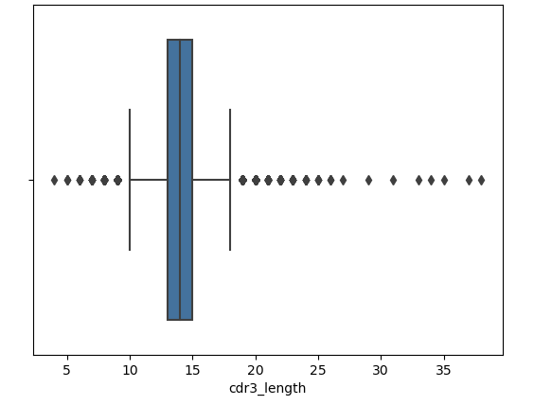
DATA EXPLORATION INSIGHTS:
Epitopes with fewer than 10 occurrences are considered insufficient for reliable modeling and are thus filtered out. This focuses the dataset on more common epitopes, which improves the model's ability to learn relevant patterns and make accurate predictions.
Calculation of the length of each CDR3 sequence and retaining those within a practical range (10 to 20 amino acids) is done as depicted by the box plot shown in Fig , as very short or very long sequences might represent sequencing errors or unusual variations that could skew the model training.

Slide 6
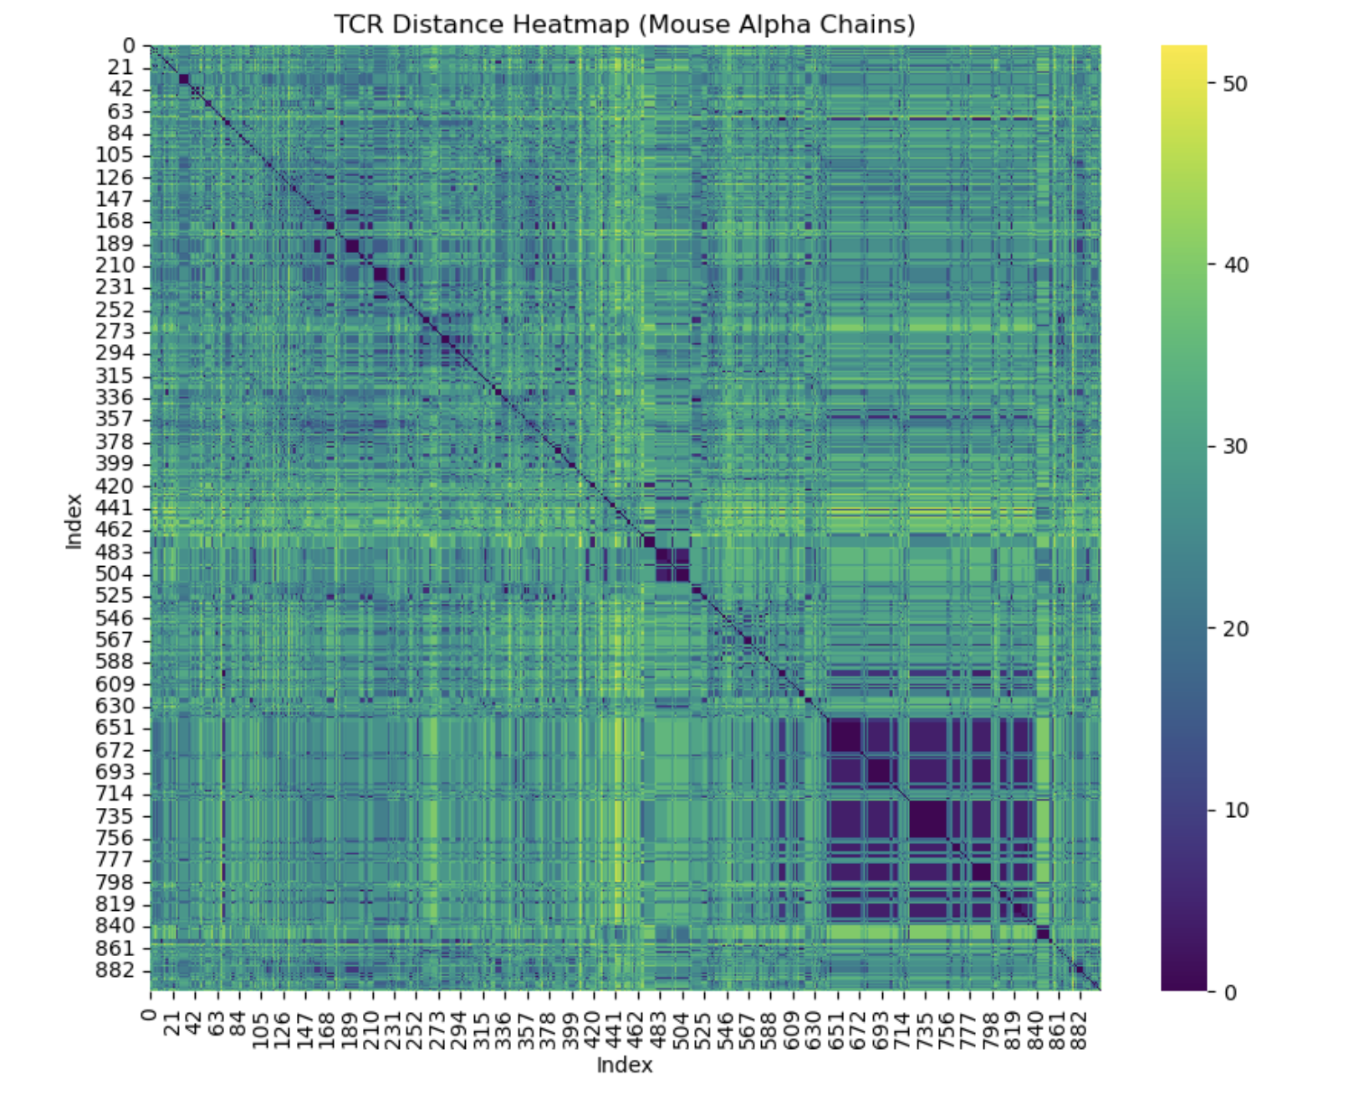
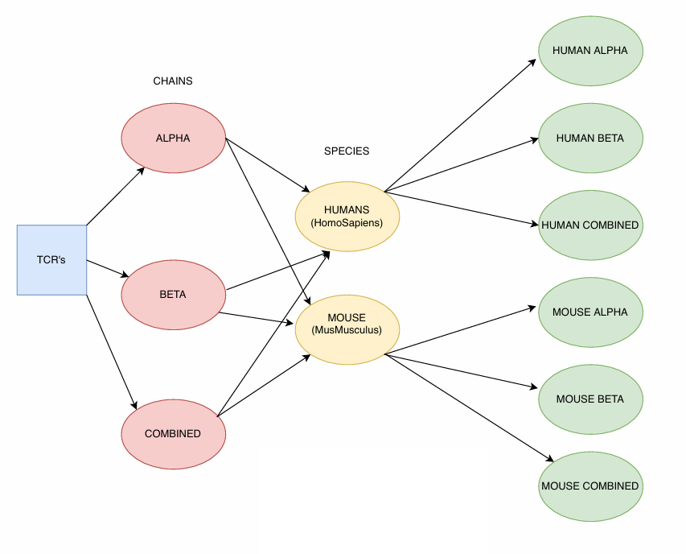
TCR DISTANCE CALCULATION USING TCRDist:
-TCRdist which is a specialized tool for computing pairwise distances between T-cell receptor sequences was used. The dataset was divided into six subsets: human alpha, human beta, combined human alpha-beta, mouse alpha, mouse beta, and combined mouse alpha-beta as shown in the Fig on the left which shows the subdivision of data for TCR Distance Matrix Calculation.
-Each subset was processed to calculate the TCR distance matrix for both alpha and beta chains. The distance matrices were essential for quantifying the similarity between TCR sequences, which is a crucial step for further analysis such as clustering and dimensionality reduction.
-For a given set of TCR sequences, the distances between all possible pairs are calculated, and the results are formed into a distance matrix as shown in the Fig on the right, each element in the matrix represents the distance or similarity between the pairs, and once the distance matrix is calculated.

Slide 7
TCR DISTANCE CALCULATION USING LEVENSHTEIN DISTANCE:
PRINCIPLE：
The minimum number of single-character edits (insertions, deletions, or substitutions) required to convert one string into another.
Create a matrix of size (m+1) x (n+1), where m and n are the lengths of the two strings.
If the two current characters are the same (i.e. the i-th character of the first string and the j-th character of the second string), then d[i][j]=d[i−1][j−1] (no additional editing is required).
If different, choose the smallest edit distance among the three operations:
Delete: 𝑑 [i−1][j]+1
Insertion: 𝑑 [i][j−1]+1
Replacement: 𝑑 [i−1][j−1]+1
The last element of the matrix, d[m][n], contains the minimum number of edit operations required to convert the entire first string into the second string.
ADVANTAGE：
1. Simplicity and intuitiveness: The calculation of Levenshtein distance is based on three basic string operations: insertion, deletion and replacement.
2. Computational efficiency: Although calculating the entire matrix requires high time complexity, by using dynamic programming, the calculation of Levenshtein distance can achieve acceptable execution speed through appropriate optimization.
3. Wide range of applicability: This method can not only be applied to text data but can also be extended to any data type that can be serialized.

Slide 8
UMAP Dimensionality Reduction
UMAP (Uniform Manifold Approximation and Projection): A popular nonlinear dimensionality reduction technique based on the theory of manifold learning. This method examines the local structure in the data, constructs a weighted neighborhood graph of high-dimensional data, and uses the minimization of cross-entropy loss between high-dimensional and low-dimensional spaces to find a low-dimensional representation.
Before dimensionality reduction, the TCR data was divided into human and mouse categories, encoded by GIANA encoding.

Slide 9
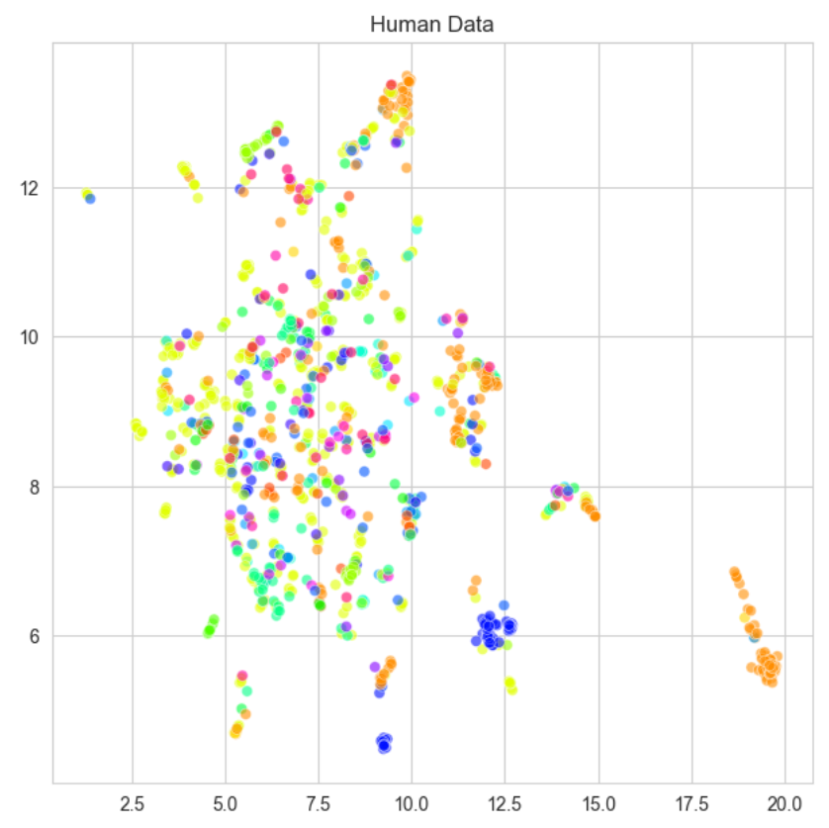
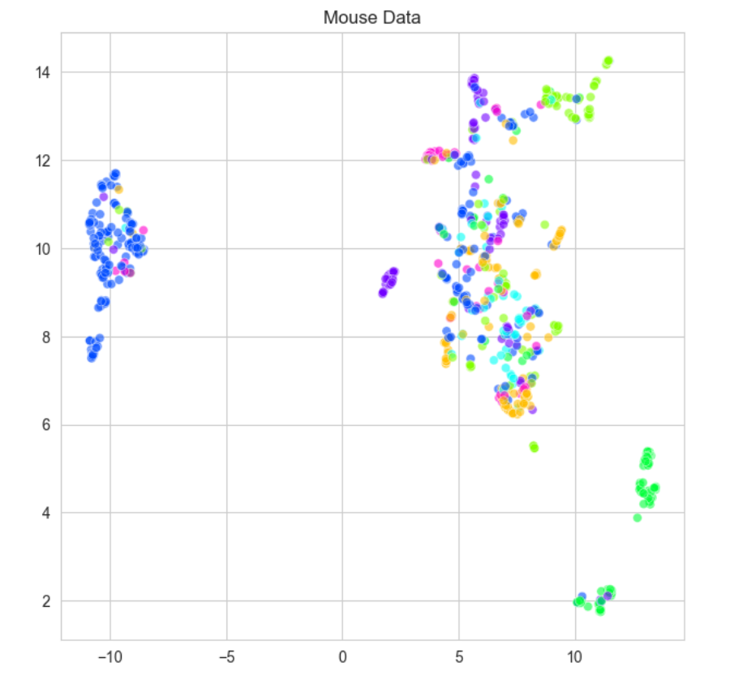
Human vs. Mouse
Results
Possible reasons
Human TCR:
More dispersed
Some small tightly clustered group
Different specificity mixed together and difficult to form distinct high-purity clusters
Mouse TCR:
Relatively compact
Obvious boundaries and distances between clusters
More concentrated specificity
Human:
Higher genetic diversity
More complex immune system
Exposure to a wide variety of pathogens in different environments
Complex distribution which hard to be captured by UMAP
Mouse:
Lower genetic diversity
Simpler immune system
Bred in the lab

Slide 10
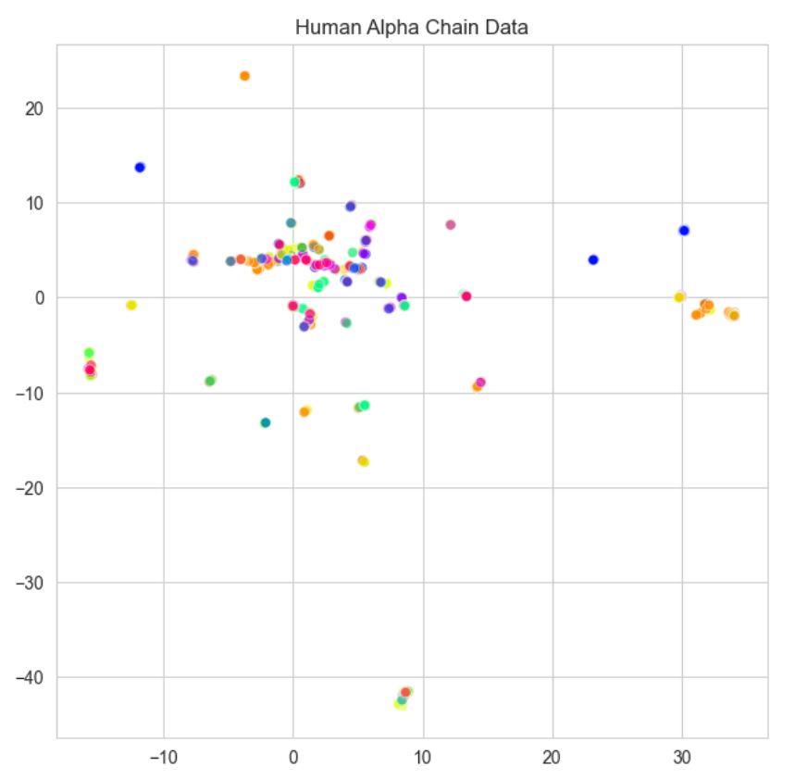
Alpha vs. Beta vs. Combined Chains
A large number of points overlap completely.
Many small dispersed clusters.
Alpha chains do not have a D region and only undergoes VJ rearrangement

Slide 11
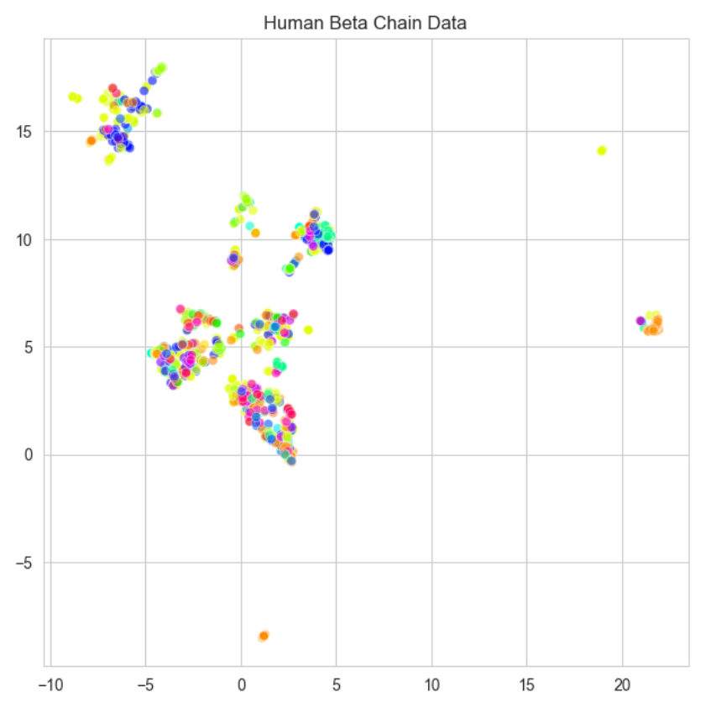
Alpha vs. Beta vs. Combined Chains
Clusters with relatively distinct boundaries.
Loose internally and closer together.
Clusters do not have higher purity.
Contains more V region and D region gene segments offering higher diversity.
Some TCR Beta chains are closer to each other.
A broader epitope recognition.

Slide 12
Clustering
2 Methods
DBSCAN: An effective density-based clustering method which can identified the clusters as high-density regions separated from low-density regions. It do not need the number of clusters and can find arbitrarily-shaped clusters. It cannot cluster data well with large differences in densities.
Hierarchical Clustering: A bottom-up clustering algorithm that gradually merges data points into clusters, and represents the similarity relationship between data points through a tree-like structure. It probes the data at different levels of granularity and can discover hierarchical structure.
3 Metrices
Pure Cluster Fraction: The percentage of pure clusters out of all clusters.
Pure Cluster Retention: The percentage of TCRs classified as pure clusters out of all TCRs.
Normalized Mutual Information(NMI): Twice the mutual information divided by the sum of the entropies of the two labels(cluster label and specificity).
Notes:
The shortcomings of DBSCAN and the advantages of hierarchical clustering are presented here.

Slide 13
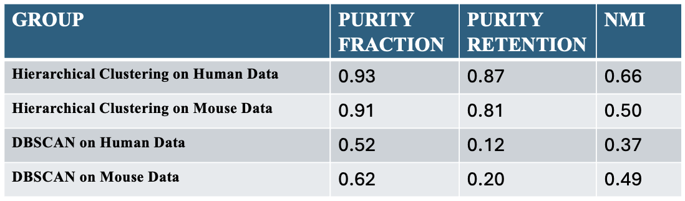
Human vs. Mouse
Hierarchical clustering performs better on human TCR and DBSCAN performs better on mouse TCR.
Human TCR data distribution have a more apparent hierarchical structure.
Mouse TCR density distribution is less dispersed or variable.

Slide 14
Agglomerative Hierarchical Clustering vs. DBSCAN
Purity fraction: DBSCAN results is half of hierarchical clustering.
Purity retention: DBSCAN is nearly only a quarter of hierarchical clustering.
NMI: DBSCAN has a relatively small gap with hierarchical clustering.
The density distribution of TCR chains can be very heterogeneous.
Hierarchical clustering is more robust and able to handle complex and variable TCR distributions

Slide 15
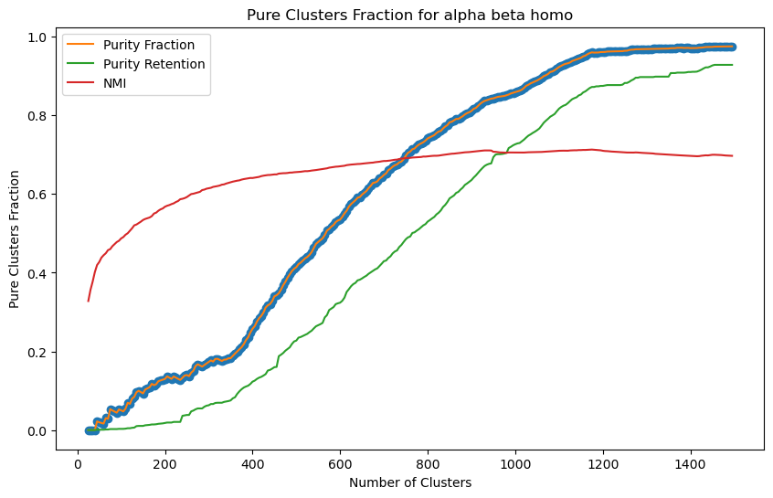
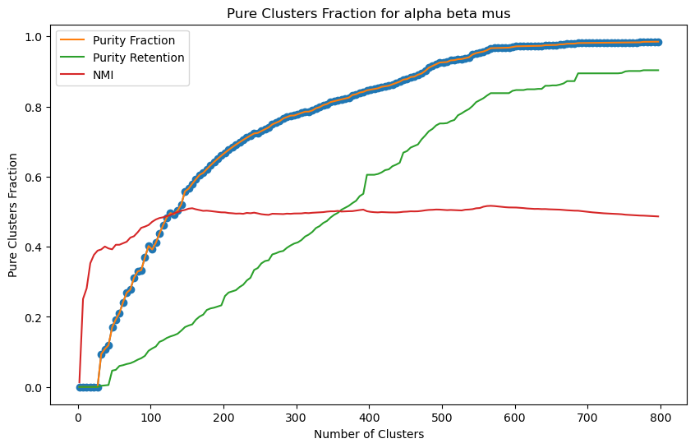
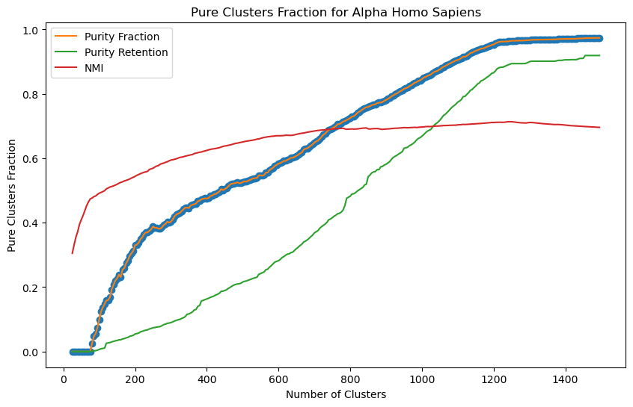
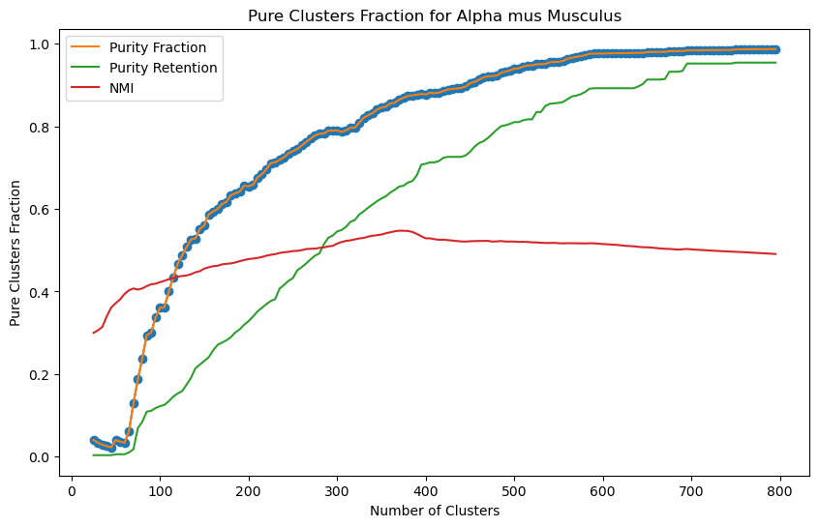
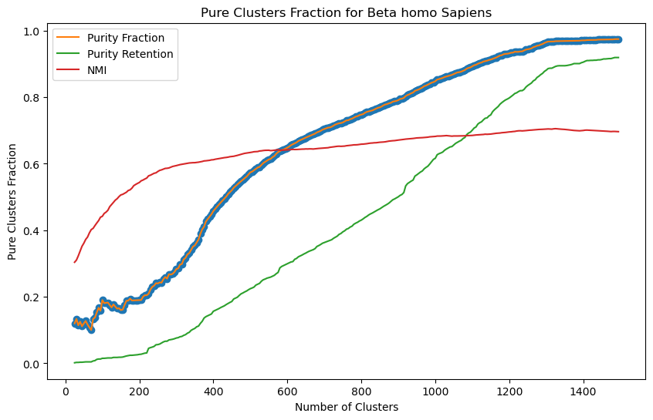
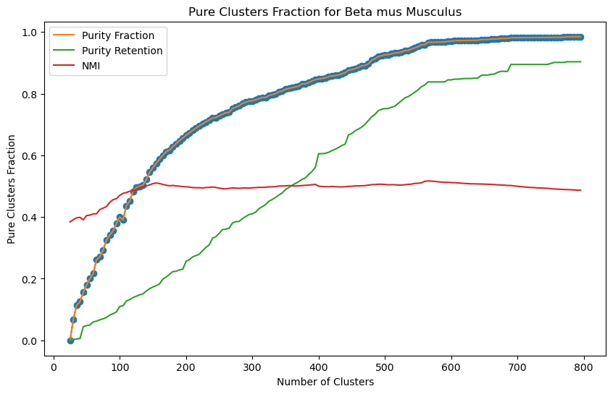
ANALYSIS ON CLUSTERING RESULTS (AGGLOMERATIVE)
calculate_purity: Determine the purity of each cluster by calculating the proportion of the most common target labels in each cluster.
pure_clusters_fraction: Calculate the proportion of clusters with perfect purity (purity of 1).
pure_cluster_retention: Evaluates the proportion of samples in all data that belong to completely pure clusters.
These six figures show the impact of cluster number on Purity Fraction, Purity Retention and NMI. It can be observed that as the number of clusters increases, Purity Fraction and NMI generally show an upward trend, indicating that the refinement of clustering helps to improve the consistency of clustering and the increase of NMI. Purity Retention increases slowly in some cases because although the number of high-purity clusters increases, the proportion of samples belonging to these clusters in the overall data does not necessarily increase significantly.

Slide 16
MODEL CREATION AND OUTCOMES:
- A decision to focus exclusively on Human Species (Homo Sapiens) was made for model building and predictions due to the significantly larger volume of data available—51,535 entries for humans compared to just 4,173 for mice (Mus Musculus).
- Focusing on human data aligns with the primary goal of applying findings directly to human medicine, avoiding the risks of undertraining and overfitting associated with the limited mouse data. This approach not only makes efficient use of the extensive human data but also enhances the clinical relevance of the predictions.
- Model evaluation was performed by segmenting the data set to obtain alpha and beta chains. Each chain potentially interacts differently with antigens, influencing the specificity and strength of immune responses.
- By analyzing them separately, it’s possible to isolate and understand the unique contributions of each chain in the antigen recognition process. This approach can help us perform a more nuanced analysis of TCR behavior, providing insights that may be obscured in combined model.
- In this study, we used accuracy and F1 score as key evaluation metrics for our models. Accuracy measures the overall correctness of the model across all classes, while the F1 score provides a balance between precision and recall, especially important in situations with class imbalance, assessing the model’s ability to correctly classify each class.

Slide 17
CHAIN TYPE | ACCURACY | F1-SCORE(WEIGHTED AVG)
ALPHA | 87.5 | 85
BETA | 87.75 | 85
Logistic Regression Classifier Results:
-Logistic regression was chosen as the baseline model for predicting TCR specificity due to the robustness of the logistic regression model and the simplicity of the binary classification task driving the choice.
-Verifying the model's performance on unseen data was done by dividing the data set into a training set and a test set. The primary evaluation metric chosen is the F1 score because the accuracy of the model can be misleading due to the unbalanced nature of the dataset. This is particularly important given the variability in epitope representation within the dataset.
- Model evaluation revealed that while the overall accuracy appeared high at approximately 87.5% for the alpha chains and 87.75% for the beta chains, the F1 scores for many classes were very low, indicating poor performance in correctly classifying many specific epitopes.
- This discrepancy between high accuracy and low F1 scores highlighted the challenges of working with imbalanced datasets and underscored the necessity of choosing appropriate metrics for performance evaluation. The classification report showed substantial variability in precision, recall, and F1 scores across different classes, with many classes showing zero values in these metrics, suggesting that the model struggled with minority classes.
- This outcome stresses the importance of further model adjustments and potentially exploring more complex models or resampling techniques to better handle class imbalance and improve the model's ability to generalize across less frequent classes.

Slide 18
CHAIN TYPE | ACCURACY | F1-SCORE(WEIGHTED AVG)
ALPHA | 89 | 88
BETA | 89 | 88
SVM Results:
- The SVM classifier recorded accuracy rates of about 87.51% for alpha chains and 89% for beta chains. This performance is quite similar to what was observed with the logistic regression model, indicating comparable overall effectiveness across the dataset.
- A closer examination of the F1 scores from the classification report reveals that the SVM faces difficulties with several classes, with many achieving zero F1 scores. This highlights the challenge of dealing with minority classes in an imbalanced dataset.
- Nonetheless, the SVM does excel in specific areas, achieving perfect F1 scores in some classes where logistic regression struggles. This shows the SVM's strength in handling certain segments of data where its optimization techniques are most effective, particularly in balancing precision and recall, as reflected by a weighted average F1 score of 0.88 for both alpha and beta chains. Although the accuracy of the SVM is similar to that of logistic regression, its higher F1 scores in certain classes suggest it could offer more dependable predictions for specific T-cell receptor specificities.

Slide 19
CHAIN TYPE | ACCURACY | F1-SCORE(WEIGHTED AVG)
ALPHA | 92 | 91
BETA | 92.5 | 91
Random Forest Classifier Results:
- The Random Forest classifier, when applied separately to the Alpha and Beta chains, shows notable strengths and weaknesses in performance. Both chains achieve high accuracy levels, with approximately 90% for Alpha and 92% for Beta, indicating the model's strong overall predictive power across the dataset. - - However, a more detailed analysis using F1 scores reveals varied performance across different epitopes. Many classes exhibit low or even zero F1 scores, indicating challenges in classifying minority classes within the imbalanced dataset. On the other hand, some classes achieve high F1 scores, demonstrating the model's ability to accurately identify specific classes.
- This variation highlights the Random Forest model's capacity to handle complex data through its ensemble approach, which captures multiple decision-making pathways and minimizes variance compared to simpler models like logistic regression. The notable weighted average F1 scores of 0.91 for Alpha and 0.92 for Beta underscore its effectiveness in balancing precision and recall among diverse classes, positioning it as a strong option for addressing the complexities of TCR specificity.

Slide 20
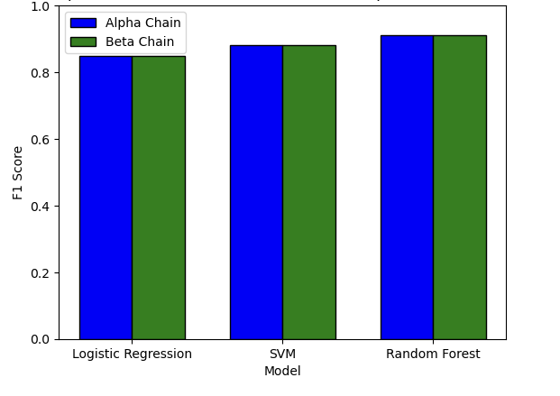
-Despite the Random Forest model’s success in general accuracy and class-specific predictions, there is still room for enhancement in precision, suggesting a need for further model refinement and strategy development.
- We performed hyperparameter tuning on the Random Forest Model to see if there could be an improvement in the performance
AFTER TUNING:
-After refining the model's settings, we noticed clear improvements. – For both the chains we get an accuracy of 93%. For the Alpha chain, adjusting the hyperparameters boosted the weighted average F1 score to 0.91, demonstrating enhanced balance in predicting various classes accurately.
- The Beta chain exhibited similar improvements, achieving a weighted average F1 score of 0.91 as well.
- These improvements suggest that the refined Random Forest model handles the dataset's varied and skewed distributions more effectively, resulting in more dependable predictions.
- Such enhancements are especially valuable in clinical environments, where precise model predictions are essential for designing effective T-cell receptor-based immunotherapies.

Slide 21

Q & A

